Slide 1
10.009 Digital World
Week 2
Man, Geok See

Slide 2
Topics
In the next few weeks, we will look at very important programming concepts
  Define your own function
  Branching: if, else, elif
  Repetitive task with loop (while-loop, for-loop)
  Compound data type: list

Slide 3
Function provided by Python
Function: takes an input argument, performs computation, returns the result(s)
Built-in function: abs, len, … (already available)
  https://docs.python.org/2/library/functions.html
Module: math.sin, cmath.sqrt
  Module = A file that contains a collection of related functions and other variables and definitions

Slide 4
Math Functions
Build-in: pow, abs, round, …
  http://docs.python.org/2/library/functions.html
Import from math module: sqrt, sin, exp, …
  http://docs.python.org/2/library/math.html
  These functions cannot be used with complex numbers; use the functions of the same name from the cmath module if you require support for complex numbers
  Another syntax: from math import sin
a = pow( 2, 3 ) # same as 2 ** 3
import math
a = math.sin( math.pi * 2 )

Slide 5
Reading keyboard input
Use raw_input (how to look up information for this built-in function?)
Take a string as function argument, display it in the Python Shell, wait until the user presses <Return> key, and returns a string object containing the text the user typed in
C = raw_input(‘C=? ‘)
C = float(C) # convert from str to float
F = (9.0 / 5) * C + 32

Slide 6
Reading keyboard input
Another function: input
>> a = input('enter something:')
enter something:1.2
>> print a
1.2
>> print type(a)
<type 'float'>
>> a = input('enter something:')
enter something:'1.2'
>> print a
1.2
>> print type(a)
<type 'str'>

Slide 7
Define and call your own function
We will discuss how to define and use your own function
Two steps
  Define the function
  Call the function (invoke the function, same as built-in functions etc)

Slide 8
Define your own fucntion
Example – centigrade to fahrenheit
Python keyword ‘def’ to begin function definition
Function name: f
Function / input argument: c
Indented statements: function body, the block of statements to be performed inside the function
Send the result back: return
A function does not do anything until it is called
def f(c):
y = 9.0/5 * c + 32
return y

Slide 9
Multiple input arguments
Example: y = ut − 1/2gt²
def yfunc(t, u):
g = 9.81
return u*t - 0.5*g*t**2
# sample calls:
y = yfunc(0.1, 6)
y = yfunc(0.1, u=6)
y = yfunc(t=0.1, u=6)
y = yfunc(u=6, t=0.1)
Sequence of arguments in the call must match exactly that of the definition, unless argument = value format is used
Implicit assignments at the beginning of the function: t = 0.1; u = 6
A function call is like a detour in the flow of execution: jumps to the function body, executes all the statements there, and comes back

Slide 10
Multiple return value
Example: compute y = ut − 1/2gt² and y’ = u − gt
Can return multiple results
  In fact, a single result of data type tuple is returned
def yfunc(t, u):
g = 9.81
y = u*t - 0.5*g*t**2
dydt = u - g*t
return y, dydt
# call:
position, velocity = yfunc(0.6, 3)
# essentially this ‘unpacks’ a tuple, more later

Slide 11
Function with no return value
Example: y = ut − 1/2gt²
def yfunc(t, u):
g = 9.81
print u*t - 0.5*g*t**2
# try:
y = yfunc(0.1, 6)
print y
When there is no return statement, Python inserts an invisible return None statement
None is a special object (type NoneType) that means “nothing” (try s = None; type(s) )
What is: print 1 + None
What is: print 1 + yfunc(0.1, 6) in the above code

Slide 12
Keyword Arguments
Some function arguments can be given a default value so that we can leave out these arguments in the call
def yfunc(t, u=10):
g = 9.81
return u*t - 0.5*g*t**2
# try:
y = yfunc(0.1)

Slide 13
Local / global variables
Local variables: variables defined inside function (e.g., y), including function argument (e.g., c)
Local variable does not exist outside the function
  Created temporarily when function is called, destroyed when function returns
Global variables: variables defined outside function (e.g., w)
Global variable can be accessed everywhere in the program
#what are global and local variables in this example:
def f(c):
y = 9.0/5 * c + 32
return y
w = f(20)

Slide 14
Local / global variables
Inside a function, can refer to a global variable
  On the contrary, outside a function, cannot refer to a local variable, because local variables are destroyed upon function exits
Inside the function, the local variable "hides" the global variable, if they have the same name
  Search local variables first, then global variables
Keyword global allows change to a global variable inside a function (not recommend to use)

Slide 15
Binding Environment (Optional)
Binding environment: Tables that specify the assignment / binding / mapping between the variable names and values (objects)
Every Python expression is always evaluated with respect to some environment
Variable | Value (object)
a | 1
b | 2.4
a=1
b=2.4

Slide 16
Binding Environment
Program starts in the global environment (module environment)
When the function is executed,
  A new environment (local environment / procedure-call environment) is created, in which the body of the function will be executed
  Variable assignment: all variable assignment stores the value in the local environment
  Variable reference: look at the local environment first, then global environment (in general, follow the chain of parent environments)
Remove local environment on function returns
  Therefore, local variables do not exist outside the function
  Exception: return a function defined in the procedure-call environment
Statement global <var> asks a new binding for <var> not be made in the procedure-call environment

Slide 17
Passing functions as arguments to another function (Optional)
Example: trapezoidal(f,a,b)
def trap(f, a, b):
return (b-a)/2.0 * (f(b) + f(a))
#f is an argument referring to a function object
#(same as a is an argument referring to a float/int object)
def xSquare(x):
return x**2
print trap(xSquare, 0, 1) # no parenthesis for xSquare, not calling it!!!
print trap(x**2, 0, 1) # not work, as we need pointer to a function object

Slide 18
Formatting text and number
print formatting
>>> print ‘This is a string’
>>> a = 1.2
>>> print a # same as print str(a)
>>> a=1.2
>>> b=2.4
>>> c = a*b
>>> print '%f times %f equals %f' % (a, b, c)
1.200000 times 2.400000 equals 2.880000
>>> print '%.2f times %.2f equals %.2f' % (a, b, c)
1.20 times 2.40 equals 2.88
The string has various ‘slots’, starting with the percentage sign, where variables can be put in
The slots have format specification (in this case, two decimals)
More formatting later…

Slide 19
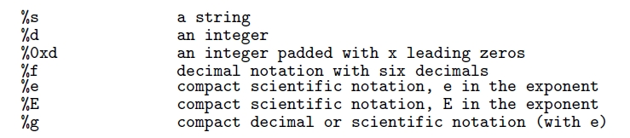
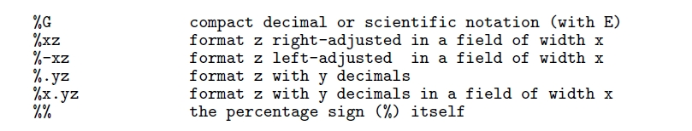
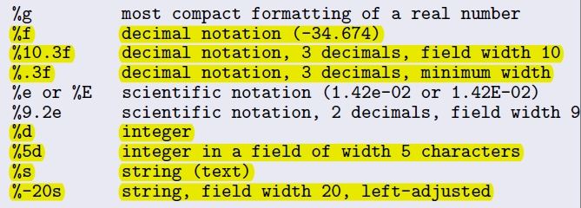
Formatting text and number
Some important text / number formatting:
Example:

